Slide 1
Machine learning
Regent College London
SWE6204

Slide 2

Machine learning
MULTIPLE REGRESSION

Slide 3
Learning objectives
Recap of Linear Regression
Define Multiple Regression
Real life applications of Multiple Regression
Practical implementation of Multiple Regression

Slide 4
recap
Linear regression: Determine association between a dependent variable and a series of other independent variables.
Results in a models to make predictions, such as predicting a company's stock price.
Showing the data in a scatter plot is ideal for determining the strength of the relationship between explanatory (independent) and dependent variables.
Increasing or decreasing trends after applying a linear regression model are observed for making a decision on applying linear model for prediction
Correlation coefficients are used to calculate how strong a relationship is between two variables.
Denoted by r and has a value between -1 and 1.
Notes:
What Is Linear Regression? How It's Used in Machine Learning
July 16, 2021
by Amal Joby

Slide 5
examples
Relationship between study time and grades, you’d probably see a positive relationship.
Relationship between time on social media and grades, you'll most likely see a negative relationship.
“grades” : dependent variable
time spent studying or on social media:independent variable.
grades depend t on how much time you spend studying.
A linear regression line is a line which is a straight line.
Notes:
What Is Linear Regression? How It's Used in Machine Learning (g2.com)

Slide 6
Simple linear equation
y is the estimated dependant variable (or the output)
m is the regression coefficient (or the slope)
x is the independent variable (or the input)
c is the constant (or the y-intercept)
Finding the relationship between variables makes it possible to predict values or outcomes. In other words, linear regression makes it possible to predict new values based on existing data.
Y=mx+c

Slide 7
Key terminologies in linear regression
Variable: number, quantity, or characteristic that can be counted or measured, also called a data item. Income, age, speed, and gender etc.
Coefficient: It's a number (usually an integer) multiplied with the variable next to it. For instance, in 7x, the number 7 is the coefficient.
Outliers: Data points significantly different from the rest. For example, imagine placing this data set in ascending order: 3, 6, 7, 10, and 54. 54 might be an outlier because it is significantly higher than the other data points.
Covariance: The direction of the linear relationship between two variables. In other words, it calculates the degree to which two variables are linearly related.
Notes:
No noise: eg. that there are no outliers in the data
No collinearity: if you have highly correlated predictors, it’s most likely your model will overfit
Linearity: assumes that the relationship between predictors and target variable is linear

Slide 8
Key terminologies in linear regression
Multivariate: two or more dependent variables resulting in a single outcome.
Residuals: The difference between the observed and predicted values of the dependent variable.
Variability: The lack of consistency or the extent to which a distribution is squeezed or stretched.
Linearity: relationship that is closely related to proportionality and can be represented as a straight line.
Collinearity: Correlation between the independent variables, such that they exhibit a linear relationship in a regression model.
Standard deviation (SD): It's a measure of the dispersion of a dataset relative to its mean or measure of how spread out numbers are. Standard deviation calculation:
https://www.youtube.com/watch?v=IaTFpp-uzp0
Notes:
No noise: eg. that there are no outliers in the data
No collinearity: if you have highly correlated predictors, it’s most likely your model will overfit
Linearity: assumes that the relationship between predictors and target variable is linear

Slide 9
Techniques to solve linear regression
Simple linear regression
Single input or one independent variable and one dependent variable to find the best relationship between two variables, given that they're in continuous nature.
For example, it can be used to predict the amount of weight gained based on the calories consumed.
Ordinary least squares
Another method to estimate the value of coefficients when there is more than one independent variable or input. It's one of the most common approaches for solving linear regression and is also known as a normal equation.
This procedure tries to minimize the sum of the squared residuals.
Gradient descent
One of the easiest and commonly used methods to solve linear regression problems.
Useful when there are one or more inputs and involves optimizing the value of coefficients by minimizing the model's error iteratively.

Slide 10
Regression
Simple linear regression is a regression model that estimates the relationship between a dependent variable and an independent variable using a straight line.
Multiple linear regression estimates the relationship between two or more independent variables and one dependent variable.
In the real world, there are an ample number of situations where many independent variables get influenced by other variables for that we have to look for other options rather than a single regression model that can only work with one independent variable.

Slide 11
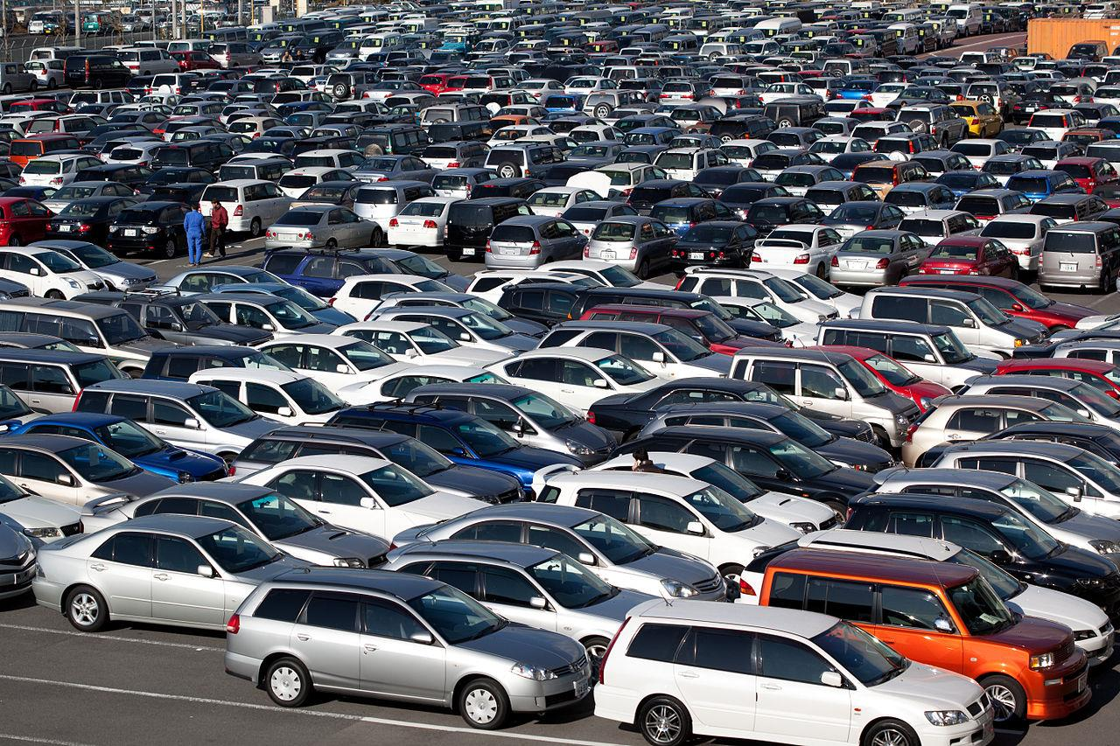
Multiple regression
What if more than one variable influences the one, you’re interested in?
Example: predicting a price for a car based on its many attributes (body style, brand, mileage, etc.)

Slide 12
Examples of multiple regression in real life
Multiple regression tries to find out a formula that can explain how factors in variables respond simultaneously to changes in others.
MR John wants to estimate the price of a house. He will collect details such as the location of the house, number of bedrooms, size in square feet, amenities available, or not. Basis these details price of the house can be predicted and how each variables are interrelated.
An agriculture scientist wants to predict the total crop yield expected for the summer. He collected details of the expected amount of rainfall, fertilizers to be used, and soil conditions. By building a Multivariate regression model scientists can predict his crop yield. With the crop yield, the scientist also tries to understand the relationship among the variables.
If an organization wants to know how much it has to pay to a new hire, they will take into account many details such as education level, number of experience, job location, has niche skill or not. Basis this information salary of an employee can be predicted, how these variables help in estimating the salary.
Economists use to predict the GDP growth of a state or a country based on parameters like total amount spent by consumers, import expenditure, total gains from exports, total savings, etc.
A company wants to predict the electricity bill of an apartment, the details needed here are the number of flats, the number of appliances in usage, the number of people at home, etc. With the help of these variables, the electricity bill can be predicted.
Notes:
mygreatlearning.2022.Introduction to Multivariate Regression Analysis.[].https://www.mygreatlearning.com/blog/introduction-to-multivariate-regression/

Slide 13
Still uses least square
We just end up with coefficients for each factor.
For example, 𝑝𝑟𝑖𝑐𝑒 = 𝛼 + 𝛽1 mileage + 𝛽2age + 𝛽3doors …123
These coefficients imply how important each factor is
Get rid of ones that don’t matter!
Can still measure fit with r-squared
Need to assume the different factors are not themselves dependent on each other.

Slide 14
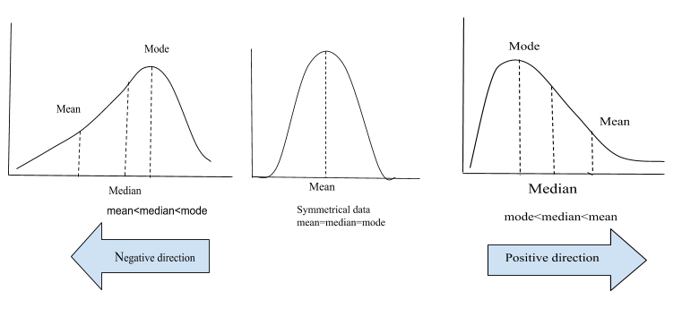
Normality ?
Linear Regression and many other models assume that the data is normally distributed. If this assumption fails the model fails to give accurate predictions.
A probability distribution with the mean 0 and standard deviation of 1 is known as standard normal distribution or Gaussian distribution.
A normal distibution is symmetric about the mean and follows a bell shaped curve . And almost 99.7% of the values lies within 3 standard deviation. The mean, median and mode of a normal distribution are equal.

Slide 15
Normality ?
SKEWNESS
Skewness of a distribution is defined as the lack of symmetry. In a symmetrical distribution, the Mean, Meadian and Mode are equal.The normal distribution has a skewness of 0. Skewness tell us about distribution of our data.
Skewness is of two types:
Positive skewness: When the tail on the right side of the distribution is longer or fatter, we say the data is positively skewed. For a positive skewness mean > median > mode.
Negative skewness: When the tail on the left side of the distribution is longer or fatter, we say that the distribution is negatively skewed. For a negative skewness mean < median < mode.
What does skewness tells us? Consider house prices ranging from 100k to 1,000,000 with the average being 500,000.
If the peak of the distribution is in left side that means our data is positively skewed and most of the houses are being sold at the price less than the average.
If the peak of the distribution is in right side that means our data is negatively skewed and most of the houses are being sold at the price greater than the average.
Now, the question is when we can say our data is moderately skewed or heavily skewed.
The thumb rule is: If the skewness is between -0.5 to +0.5 then we can say data is fairly symmetrical. If the skewness is between -1 to -0.5 or 0.5 to 1 then data is moderately skewed. And if the skewness is less than -1 and greater than +1 then our data is heavily skewed.

Slide 16
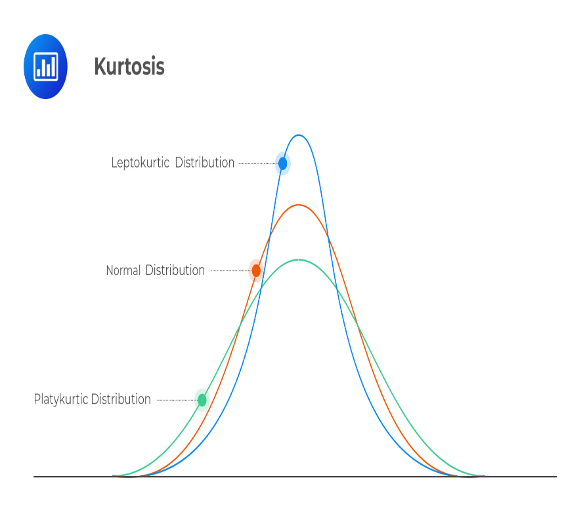
kurtosis
About the shape or peakedness or flatness of the distribution but this is not correct.
Kurtosis tell us about the tails behaviour. It is actually the measure of outliers present in the distribution.
Kurtosis are of three types:
Mesokurtic: When the tails of the distibution is similar to the normal distribution then it is mesokurtic. The kutosis for normal distibution is 3.
Leptokurtic: If the kurtosis is greater than 3 then it is leptokurtic. In this case, the tails will be heavier than the normal distribution which means lots of outliers are present in the data. It can be recognized as thin bell shaped distribution with a peak higher than normal distribution.
Platykurtic: Kurtosis will be less than 3 which implies thinner tail or lack of outliers than normal distribution. In case of platykurtic, bell shaped distribution will be broader and peak will be lower than the mesokurtic.
Notes:
Skewness-and-kurtosis/SKEWNESS_AND_KURTOSIS_(1).ipynb at master · manvendra7/Skewness-and-kurtosis · GitHub

Slide 17
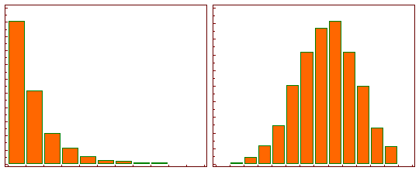
Log tranformation
When our original continuous data do not follow the bell curve, we can log transform this data to make it as “normal” as possible so that the statistical analysis results from this data become more valid. In other words, the log transformation reduces or removes the skewness of our original data. import numpy as np
x = [1, 2, 3, 4, 5]
y = np.log(x)
y
Notes:
Htton,S,K.2020.https://medium.com/@kyawsawhtoon/log-transformation-purpose-and-interpretation-9444b4b049c9

Slide 18

Cost function
Using a multivariate model helps us compare coefficients across outcomes. What makes a multivariate or multiple linear regression a better model is a small cost function.
Cost Function
In simple words it is a function that assigns a cost to instances where the model deviates from the observed data. In this case, our cost is the sum of squared errors. The cost function for multiple linear regression is given by:
We can understand this equation as the summation of square of difference between our predicted value and the actual value divided by twice of length of data set. A smaller mean squared error implies a better performance. Generally, a cost function is used along with the Gradient Descent algorithm to find the best parameters.

Slide 19
Steps in machine learning
STEP 1: Explore the DATA
STEP 2: VISUALISING THE DATA
STEP 3: FEATURE ENGINEERING
STEP 4: FITTING THE MODEL
STEP 5: Prediction

Slide 20
Video -visual
Watch the you tube video on Multiple regression
https://www.youtube.com/watch?v=zITIFTsivN8 (6 minutes)

Slide 21
reference
mygreatlearning.2022.Introduction to Multivariate Regression Analysis.[Online].Available at: https://www.mygreatlearning.com/blog/introduction-to-multivariate-regression/
Raj,A.2020. Applied Multivariate Regression .[Online].Available at: https://towardsdatascience.com/applied-multivariate-regression-faef8ddbf807
Visually Explained.2022. Linear Regression in 2 minutes. .[Online].Available at:https://www.youtube.com/watch?v=CtsRRUddV2s
Unfold Data Science.2020.When To Use Regression|Linear Regression Analysis|Machine Learning Algorithms .[Online].Available at:https://www.youtube.com/watch?v=rz6d5lAQhXg
Unfold Data Science.2020.Implementing machine learning in Python|How to Implement Machine Learning In Python Algorithms .[Online].Available at: https://www.youtube.com/watch?v=fKUfFgiSJx0
Htton,S,K.2020. .[Online].Available at: https://medium.com/@kyawsawhtoon/log-transformation-purpose-and-interpretation-9444b4b049c9
manvendra7,2023.WHY DO WE CARE SO MUCH ABOUT NORAMLITY ?. .[Online].Available at: https://github.com/manvendra7/Skewness-and-kurtosis/blob/master/SKEWNESS_AND_KURTOSIS_(1).ipynb
Radečić,D.2020.Top 3 Methods for Handling Skewed Data. https://towardsdatascience.com/top-3-methods-for-handling-skewed-data-1334e0debf45
Student's Marks Regression | Kaggle
How to Calculate Skewness and Kurtosis in Python? – GeeksforGeeks
Seaborn - Linear Relationships (tutorialspoint.com)

Slide 22
+44 (0)207 016 8000
info@rcl.ac.uk

